Slide 1
Phase of project Front-end web development

Slide 2
Languages used : HTML & CSS
Admin Version

Slide 3
Admin operation
Add New Patient
Archive
Update patient Information
Make an appointment

Slide 4
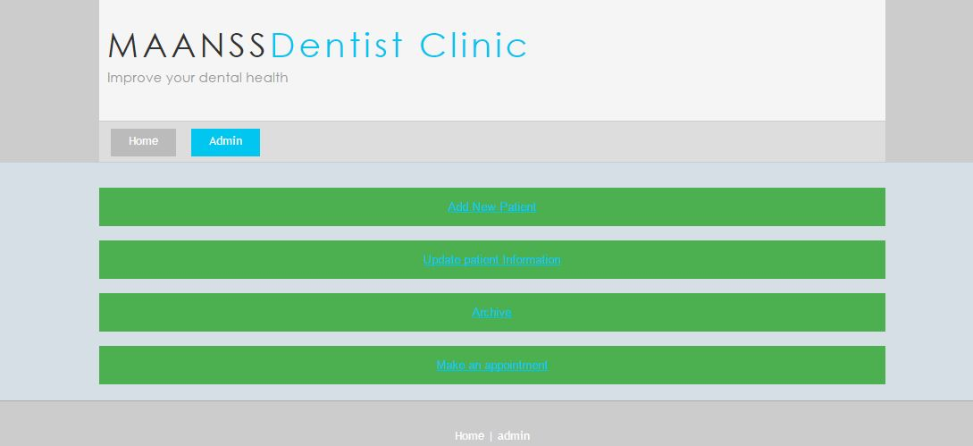

Slide 5

Admin can login and logout and make operations

